Slide 1

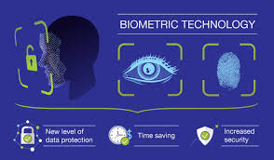
SHOPTALK OF THE MONTH
BIOMETRICS TECHNOLOGY
MARCH
2026
Name:-AYUSH PRASAD
Course:- COMPUTER SCIENCE
Section:- C1
Centre:- RD TATA TECHNICAL EDUCATION CENTRE,NTTF

Slide 2
What is Biometrics?
Biometrics is a technology used to identify or verify a person based on unique physical or behavioral characteristics
These traits are distinct for every individual
It is mainly used for authentication and security purposes
Common examples include fingerprint, face recognition, and iris scan

Slide 3
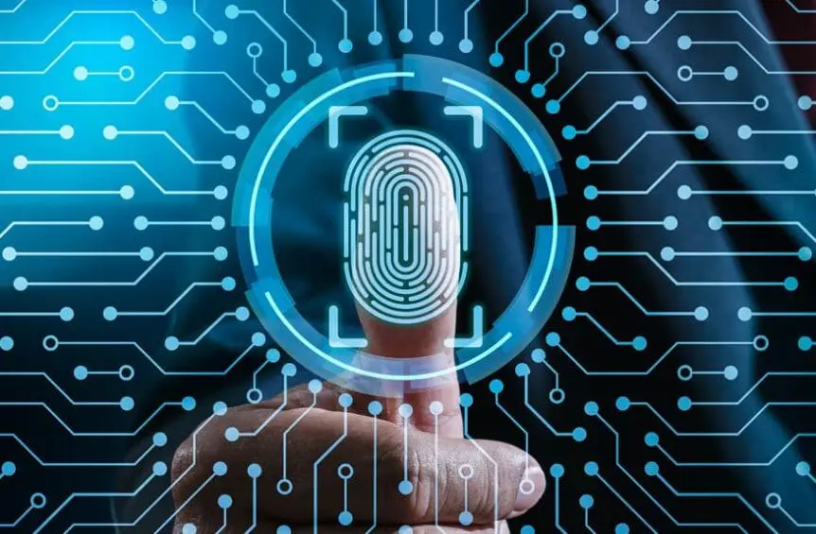
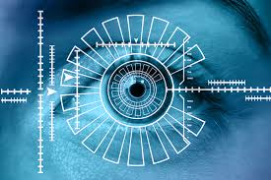
Types of Biometrics
1. Physical Biometrics (Body-based)
Fingerprint
Face Recognition
Iris / Retina Scan
2. Behavioral Biometrics (Action-based)
Voice Recognition
Signature
Typing Pattern

Slide 4
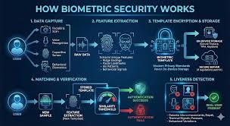
How Biometrics Works?
Data Capture – Scan fingerprint, face, or iris
Feature Extraction – Identify unique features
Storage – Save data securely in a database
Matching – Compare with stored data for verification

Slide 5
Applications of Biometrics
📱 Smartphones – Face unlock & fingerprint authentication
🏦 Smartphones Banking & ATMs – Secure transactions & identity verification
🧑‍💼 Attendance Systems – Employee/student tracking
✈️ Airports & Security – Fast passenger identification
🆔Government Systems – Digital ID and citizen verification

Slide 6
Advantages of Biometrics
High Security – Uses unique personal traits
No Password Needed – Eliminates remembering passwords
Fast & Convenient – Quick access and verification
Difficult to Duplicate – Hard to copy or fake

Slide 7
Disadvantages of Biometrics
Privacy Concerns – Personal data may be misused
High Cost – Expensive to install and maintain
Accuracy Issues – May fail due to injury or changes
Security Risks – Data theft can be serious if compromised

Slide 8
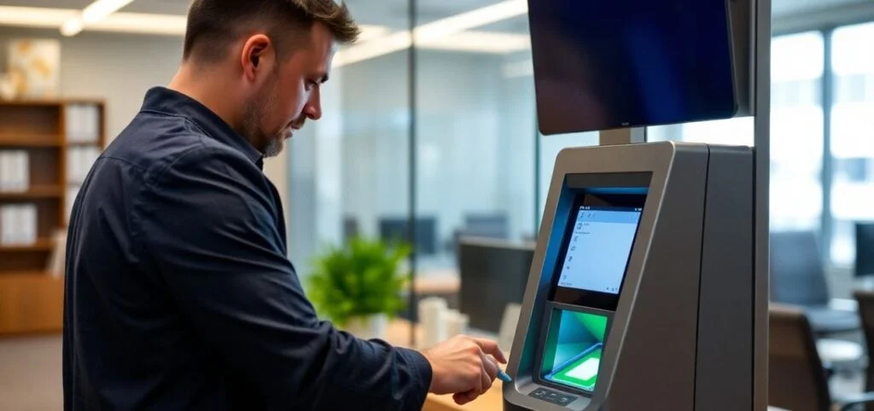
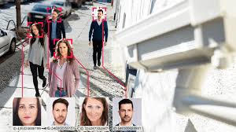
Real-Life Examples
Smartphone Unlocking – Face ID & Fingerprint
Airport Security – Facial recognition for fast check-in
Banking Services – Biometric verification for transactions
Aadhaar System (India) – Identity authentication using biometrics

Slide 9
Future of Biometrics
🤖 AI-Powered Recognition – Faster and more accurate identification
🔍 Contactless Biometrics – Face & iris scans without touch
📱 Smart Device Integration – Used in IoT, homes, and wearables
🔐 Advanced Security Systems – Stronger and safer digital identities

Slide 10
Conclusion
Biometrics is transforming modern security systems
Provides high accuracy and reliable identification
Reduces dependency on passwords and ID cards
Widely used in banking, healthcare, and government sectors
Improves user convenience and system efficiency
Faces challenges like privacy and data protection
Future growth with AI and advanced technologies

Slide 11
Conclusion
Biometrics is transforming modern security systems
Provides high accuracy and reliable identification
Reduces dependency on passwords and ID cards
Widely used in banking, healthcare, and government sectors
Improves user convenience and system efficiency
Faces challenges like privacy and data protection
Future growth with AI and advanced technologies

Slide 12
THANKYOU

